Slide 1

HR REPORT ANALYSIS
Made By:- Ankush Rawal

Slide 2
Introduction
Embarking on a data-driven journey, I've meticulously dissected a dataset using the dynamic duo of Microsoft Excel and Power BI. Unveiling hidden patterns and trends, this analysis showcases the synergy between Excel's versatility and Power BI's robust visualization capabilities. From meticulous data cleaning to insightful visualizations, join me in unraveling the compelling story woven into this dataset through the lens of Excel and Power BI

Slide 3
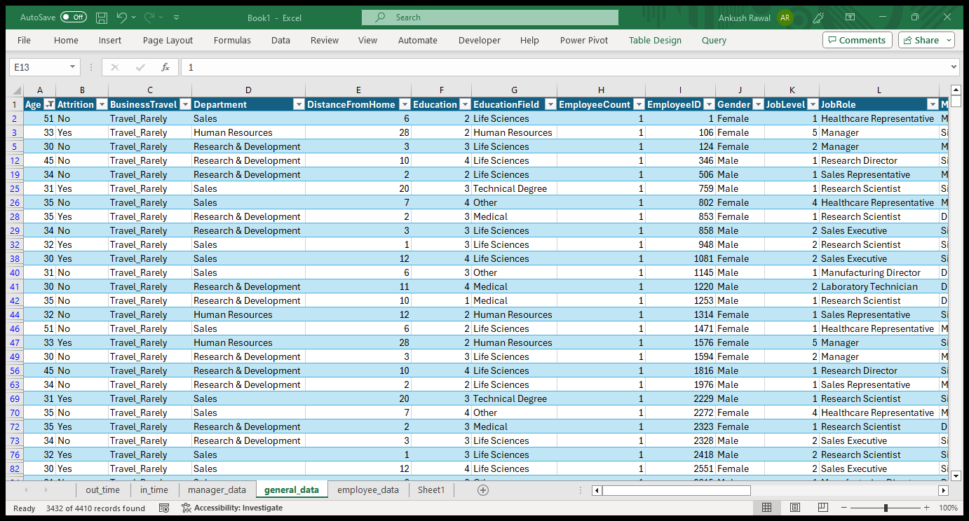
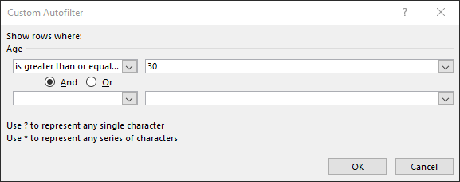
Using Excel, how would you filter the dataset to only show employees aged 30 and above?

Slide 4
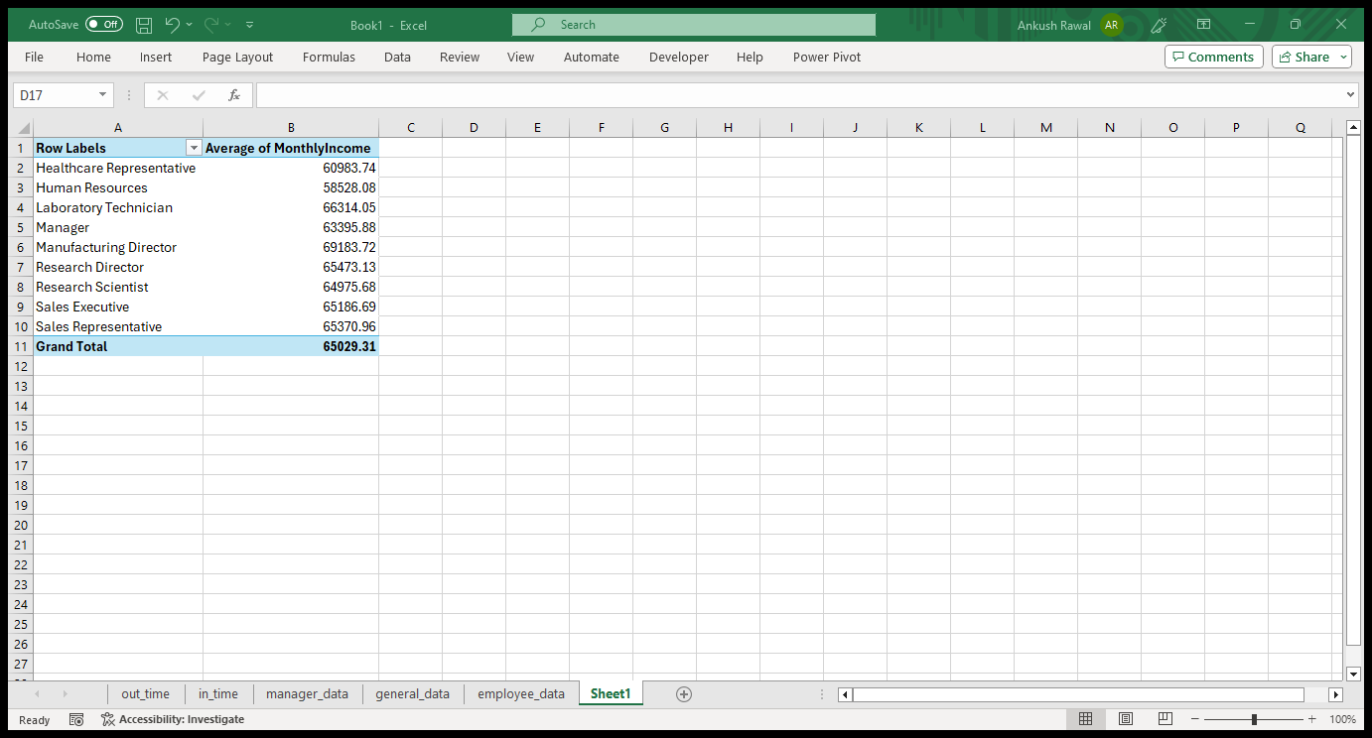
Create a pivot table to summarize the average Monthly Income by Job Role.

Slide 5
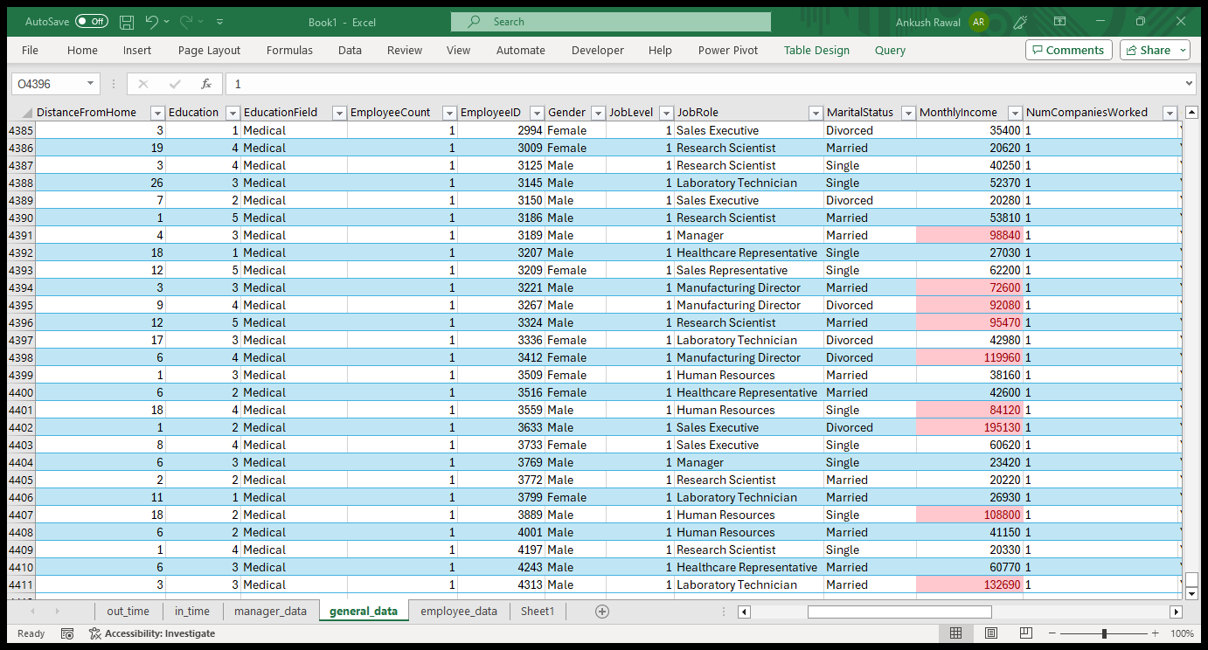
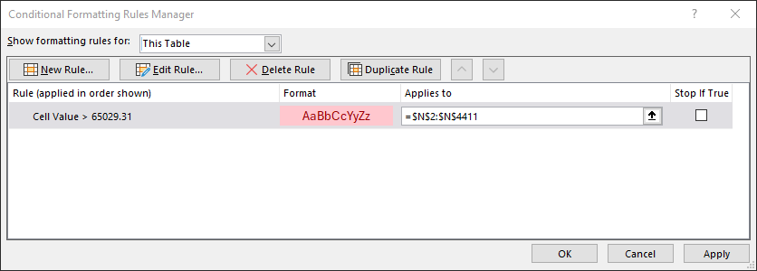
Apply conditional formatting to highlight employees with Monthly Income above the company's average income.

Slide 6
Create a bar chart in Excel to visualize the distribution of employee ages.

Slide 7
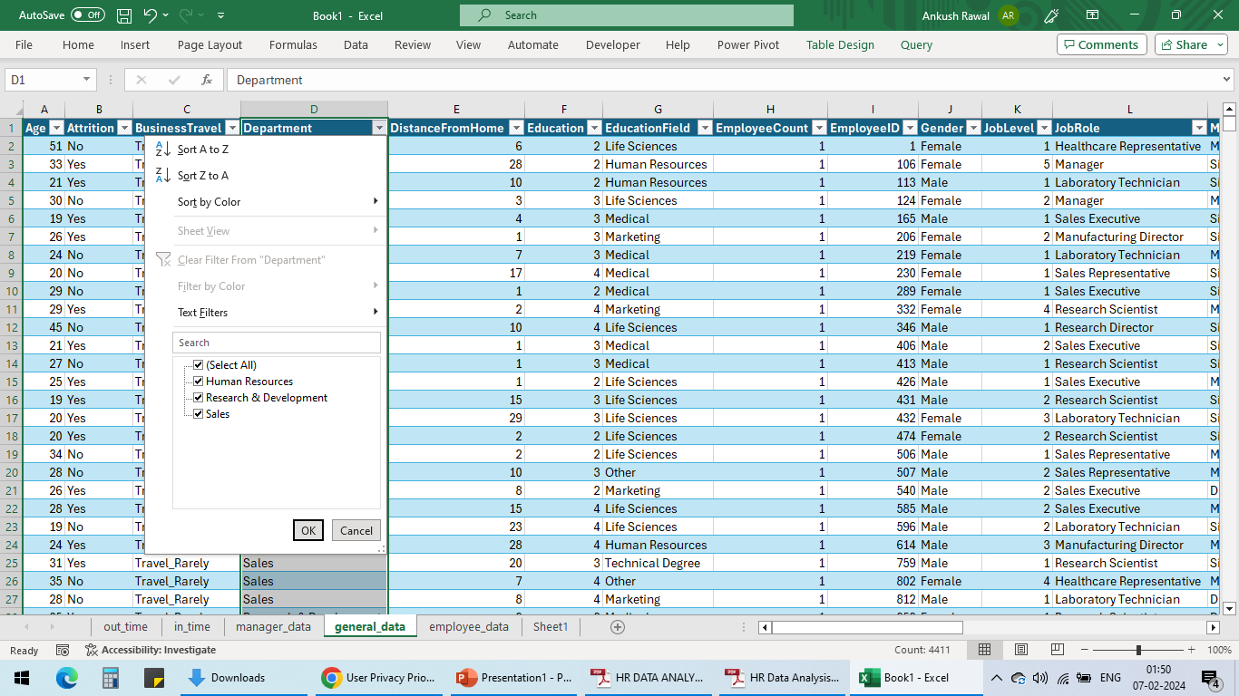
Identify and clean any missing or inconsistent data in the "Department" column.
By checking the Department column, it seems that the column data is consistent, clean and doesn’t have any missing data.

Slide 8
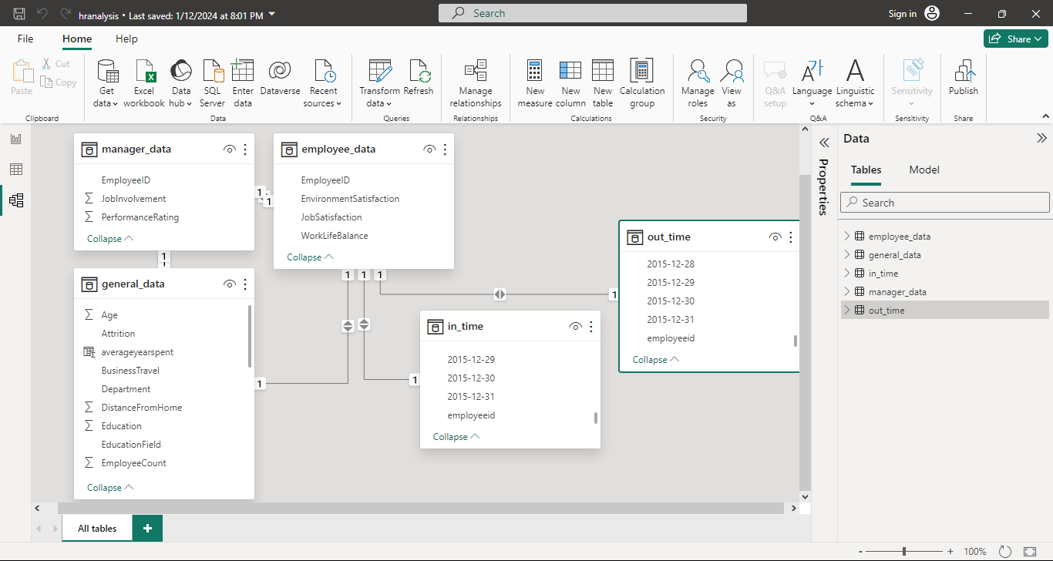
In Power BI, establish a relationship between the "EmployeeID" in the employee data and the "EmployeeID" in the time tracking data.

Slide 9
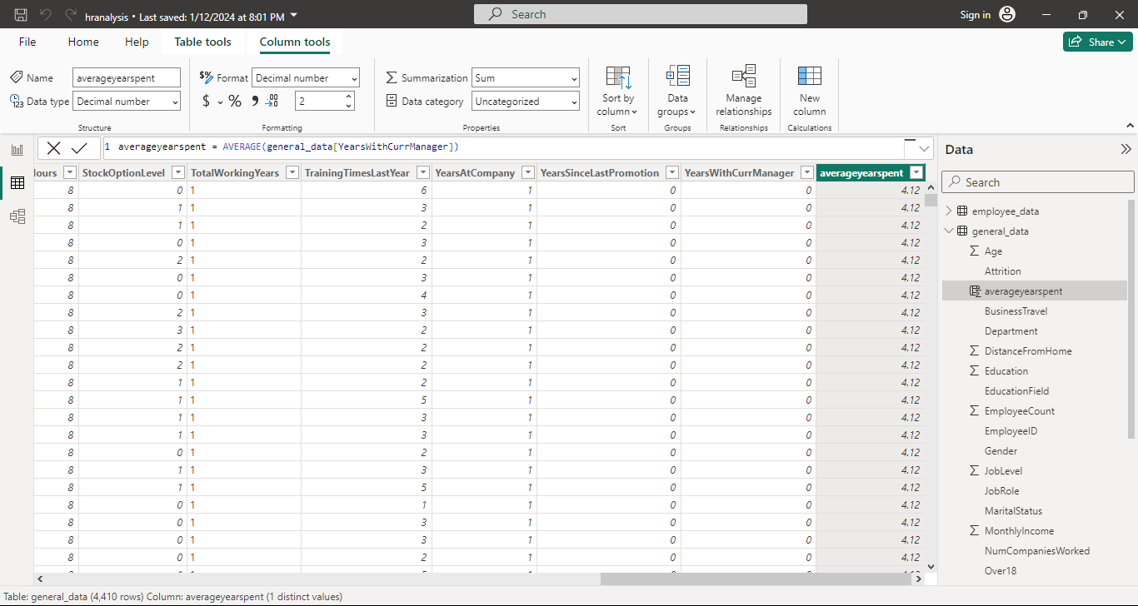
Using DAX, create a calculated column that calculates the average years an employee has spent with their current manager.

Slide 10
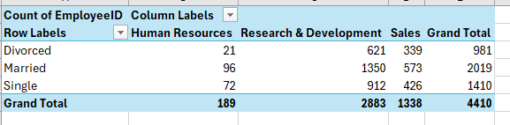
Using Excel, create a pivot table that displays the count of employees in each Marital Status category, segmented by Department.

Slide 11
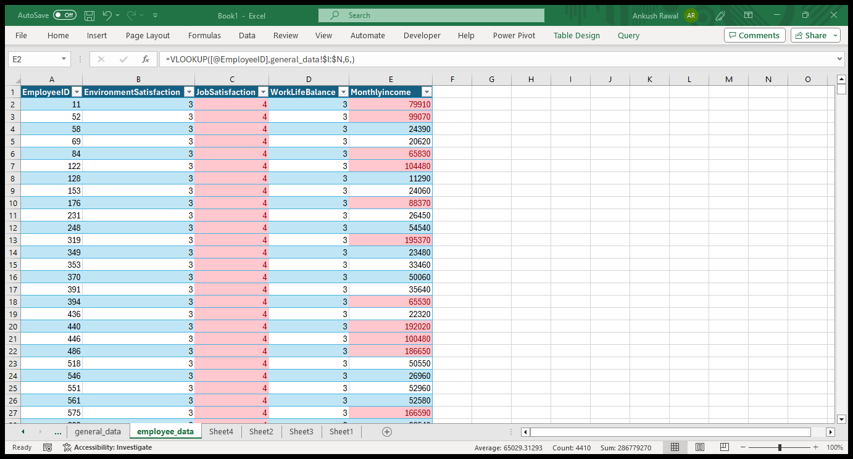
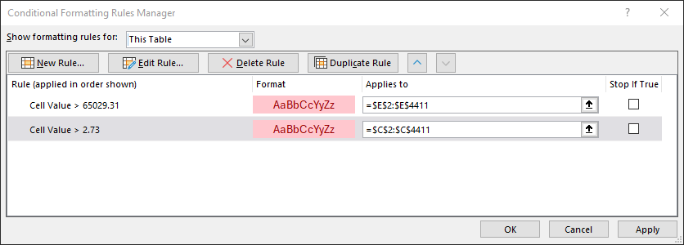
Apply conditional formatting to highlight employees with both above-average Monthly Income and above-average Job Satisfaction.

Slide 12
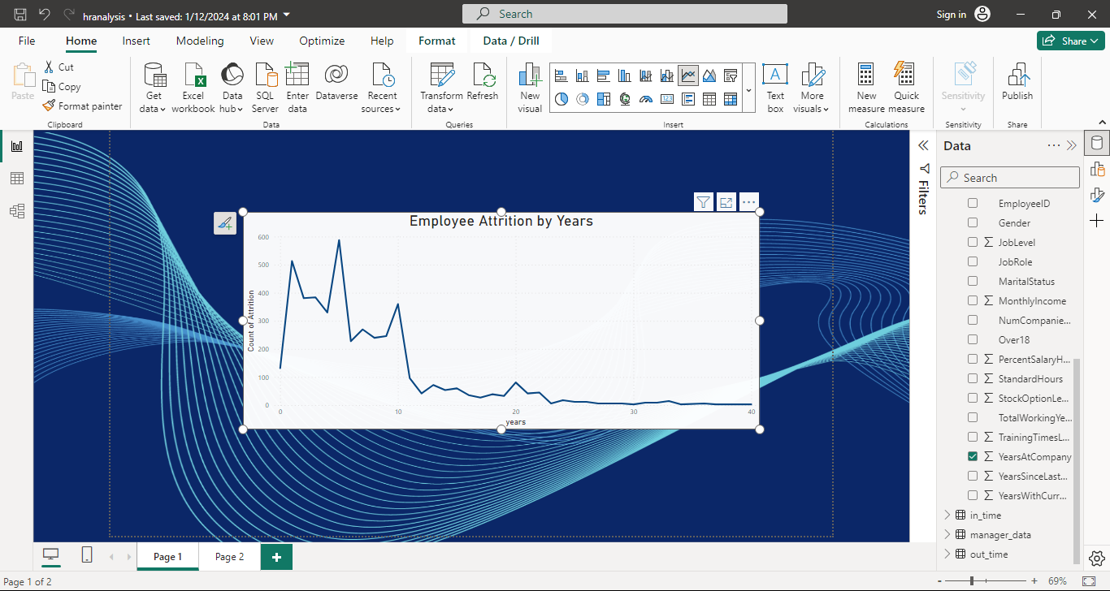
In Power BI, create a line chart that visualizes the trend of Employee Attrition over the years. line chart

Slide 13
Describe how you would create a star schema for this dataset, explaining the benefits of doing so.
Create Dimension Tables:
Create the Employee Dimension Table, Manager Dimension Table, and Time Dimension Table. Populate these tables with relevant attributes and data.
Ensure that each dimension table contains a primary key (e.g., EmployeeID, ManagerID, Date) to uniquely identify each record.
Create the Fact Table:
Create the Performance Fact Table. Define the relevant metrics and measures that you want to analyze (e.g., Attrition Rate, Performance Score).
Include foreign keys in the fact table to link to the respective dimension tables (e.g., EmployeeID, ManagerID, Date).
Establish Relationships:
Define relationships between the fact table and each dimension table. These relationships are typically established using the foreign keys present in the fact table and the corresponding primary keys in the dimension tables.
Ensure that relationships are correctly defined to enable efficient data retrieval and analysis.
Model the Star Schema:
Visualize the star schema in your data modeling tool or database management system. The fact table sits at the center of the star, with dimension tables branching out from it like the points of a star.
Ensure that the star schema follows the principle of normalization, with dimension tables containing atomic, non-redundant data.
Benefits of using a star schema:
Simplicity and Ease of Use: Star schemas are simple to understand and navigate, making them user-friendly for business analysts and report developers.
Query Performance: Star schemas optimize query performance by minimizing the number of joins required to retrieve data. This improves the speed and efficiency of analytical queries.
Scalability: Star schemas are highly scalable and can accommodate large volumes of data without sacrificing performance.
Flexibility: Star schemas provide flexibility in data analysis, allowing users to slice and dice data across different dimensions easily.
Aggregation: Star schemas facilitate pre-aggregation of data at different levels of granularity, enabling faster query response times for summary and aggregate queries.

Slide 14
Using DAX, calculate the rolling 3-month average of Monthly Income for each employee.
RollingAvgMonthlyIncome = CALCULATE( AVERAGE(EmployeeTable[MonthlyIncome]), FILTER( ALL(EmployeeTable), EmployeeTable[EmployeeID] = EARLIER(EmployeeTable[EmployeeID]) && EmployeeTable[DateColumn] <= EARLIER(EmployeeTable[DateColumn]) && EmployeeTable[DateColumn] > DATEADD(EARLIER(EmployeeTable[DateColumn]), -3, MONTH) ) )

Slide 15
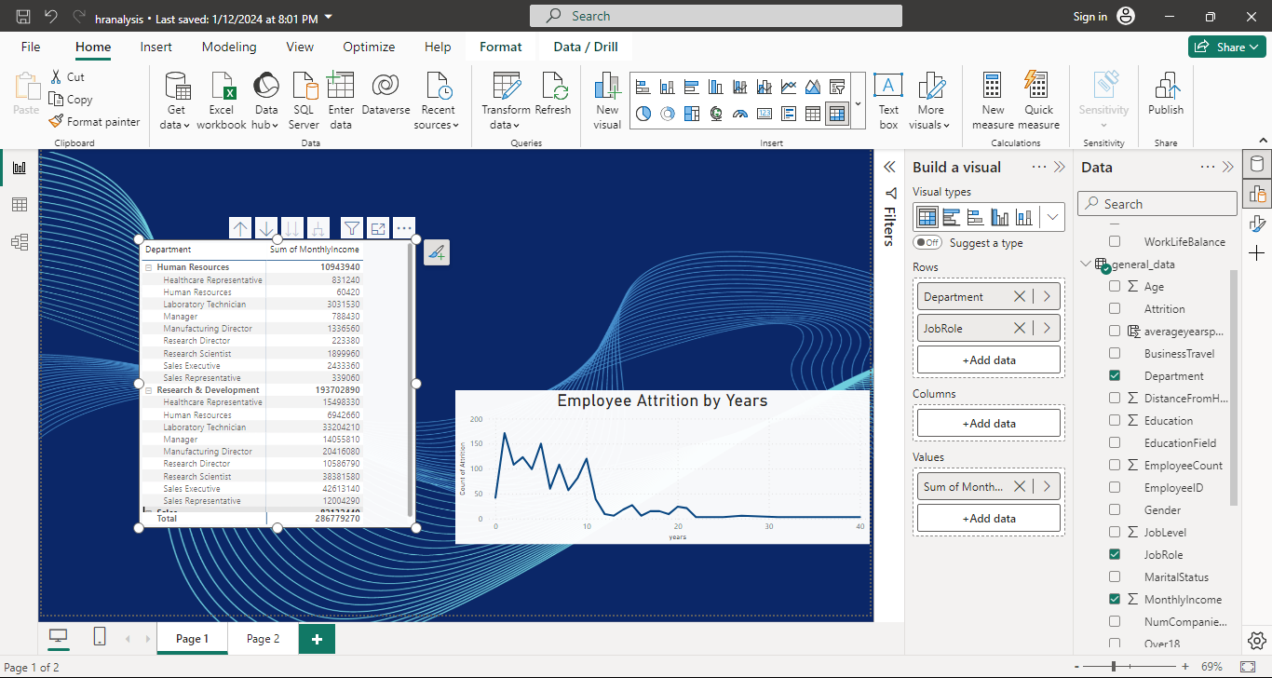
Create a hierarchy in Power BI that allows users to drill down from Department to Job Role to further narrow their analysis.
Step 1 : We use hierarchy in Power BI using MATRIX. First Select a Matrix.
Step 2 : Dragged and dropped Department and JobRole into rows section and MonthlyIncome in values section.
Step 3 : Use the + icon in the matrix view to see the hierarchy.

Slide 16
How can you set up parameterized queries in Power BI to allow users to filter data based on the Distance from Home column?
1.Edit Queries:
1. In Power BI Desktop, go to the "Home" tab on the ribbon.
2. Click on "Transform Data" to open the Power Query Editor.
2.Create a Parameter:
1. In the Power Query Editor, go to the "Home" tab and click on "Manage Parameters."
2. Click on "New" to create a new parameter. Name it something like "Distance Parameter."
3. Choose the data type, such as Decimal Number, as appropriate for your "Distance from Home" column.
4. Set the Suggested Values and Current Value as needed.
5. Click "OK" to create the parameter.
3.Filter Data Using the Parameter:
1. In the Power Query Editor, go to the "Home" tab and click on "Advanced Editor."
2. Write a query that filters the data based on the created parameter
4.Load Data:
1. Close the Power Query Editor and load the data into Power BI.
5.Set Up Parameter in Report:
1. In Power BI Desktop, go to the "Home" tab.
2. Click on "New Parameter" to create a parameter. Link it to the parameter you created in the query.
3. Create a slicer or any other visual element that allows users to interactively set the "Distance Parameter."
6.Test the Parameterized Query:
1. Go back to the report view.
2. Interact with the slicer or input the parameter value manually to see how the data updates based on the "Distance from Home" filter.

Slide 17
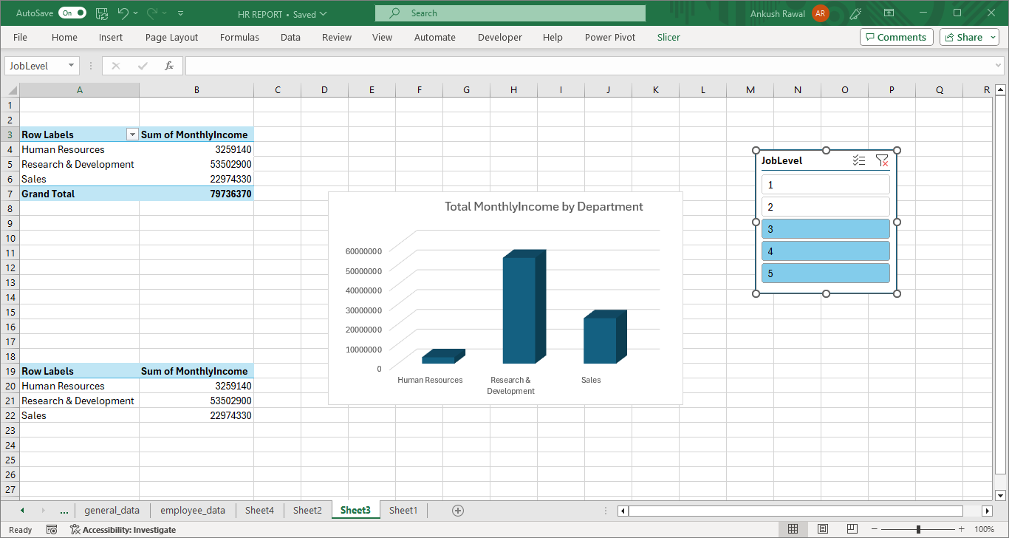
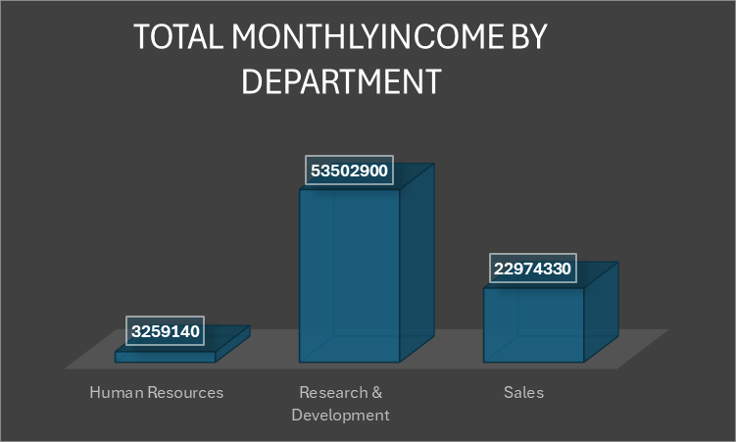
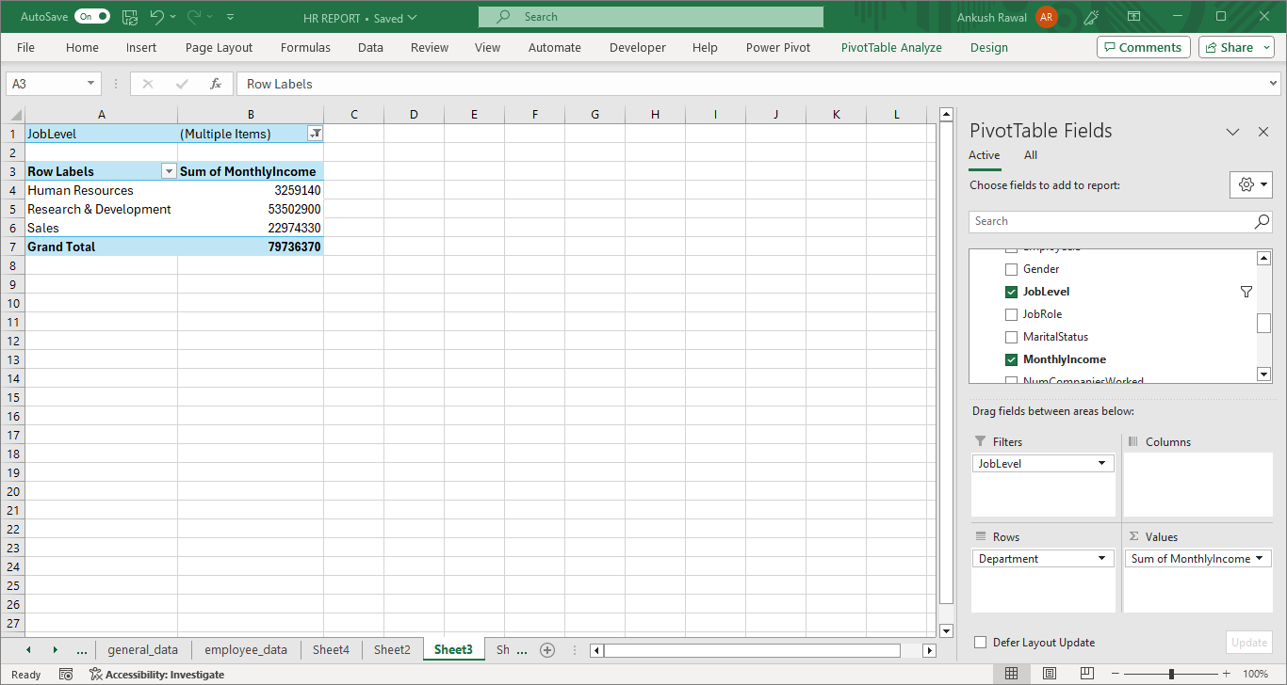
In Excel, calculate the total Monthly Income for each Department, considering only the employees with a Job Level greater than or equal to 3.

Slide 18
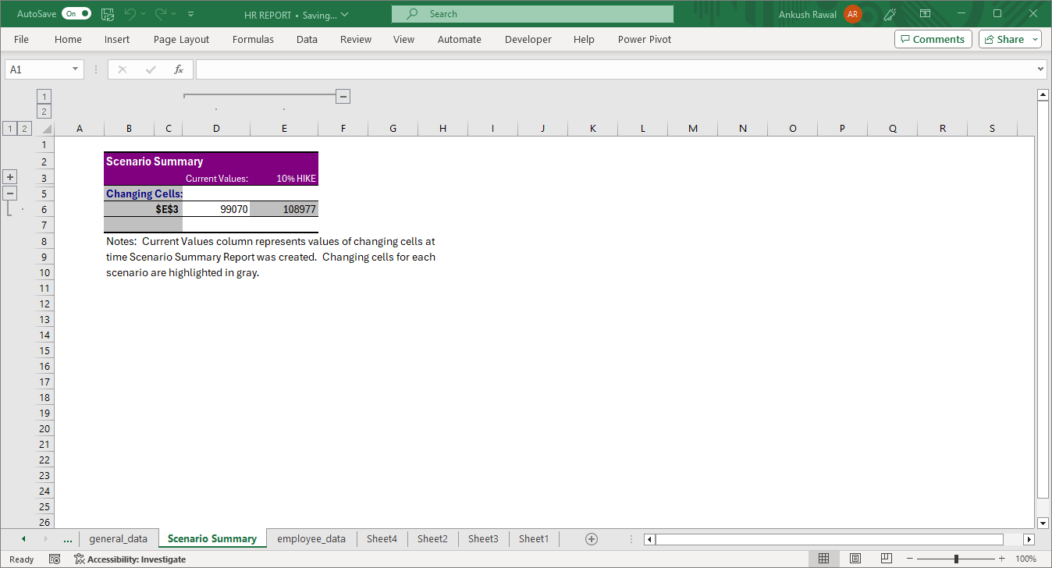
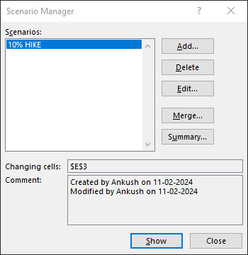
Explain how to perform a What-If analysis in Excel to understand the impact of a 10% increase in Percent Salary Hike on Monthly Income.

Slide 19
Verify if the data adheres to a predefined schema. What actions would you take if you find inconsistencies?
➢ Review the data to find any fields, values or formats that deviate from the predefined schema.
➢ Document the inconsistencies, noting the specific fields or records that don’t adhere to the specific schema.
➢ Understand the reasons behind the inconsistencies. It could be data entry errors, system issues or changes in source systems.
➢ Set up validation rules to prevent future inconsistencies. This ensures that new data entering the system conforms to the defined schema.
➢ Implement ongoing monitoring processes to catch and rectify inconsistencies early on, maintaining data quality over time.
➢ Update documentation to reflect any changes made to the schema or validation rules.
➢ Establish a continuous improvement process to regularly review and enhance data quality measures.

Slide 20
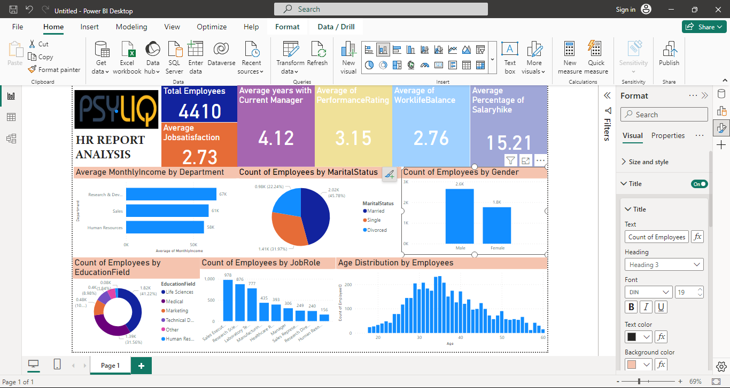

Slide 21


